Slide 1
MBSE
Social Media – 3 May 2017

Slide 2
Importance of Social Media to SEO
Social Links May or May Not Boost Your Search Rank
  Links to your content on Facebook, Twitter, LinkedIn, Google+, YouTube and other social networks help the search engines understand what websites are credible and should be ranked for what keyword phrases.
Social Media Profiles Rank in Search Engines
Social Media Channels Are Search Engines, Too
Ultimately, the web is all about building relationships, fostering audiences, expressing identity and sharing ideas––it’s inherently social, and there’s no reason that SEO best practices would go against the grain, especially since the rules that govern SEO are ultimately meant to make the web a more enjoyable and useful place.

Slide 3
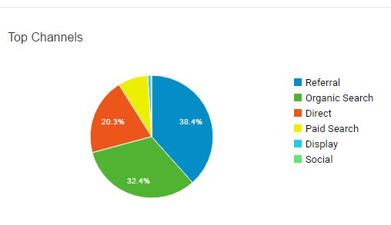
March: 7162 visits (SEO /Organic Search 32.4%)

Slide 4
Social Media Assets
Facebook
135 Likes
LinkedIn
870 followers (alumni)
Blog
New
Twitter
Unused

Slide 5
Content
Blog
  Monthly / weekly (Update, anything from 100 words to 450) RE: Courses & MBSE related – core objective is to add value/ credibility (non sales push)
  Blog activity is pushed via:
    LinkedIn
    Facebook
    Twitter
Facebook
  Corporate culture (FUN/ Corporate responsibility/ Attending seminars etc)
  Course intakes
LinkedIn
  Mostly blogs / but can also include announcements
  Course intakes
Twitter
  Blog
  Course intakes
*to be added and defined within working group (take your platform into account)

Slide 6
Access
Admin access to post
Responsibility (Online behaviour)
  Draft guidelines

